Slide 1
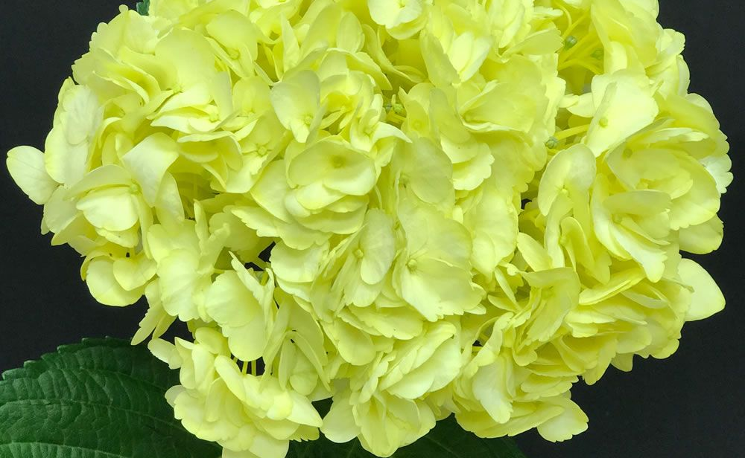
Times Used: Number Used: Level:
Annabelle Hydrangea

Slide 2
Times Used: Number Used: Level:
Black Tea

Slide 3
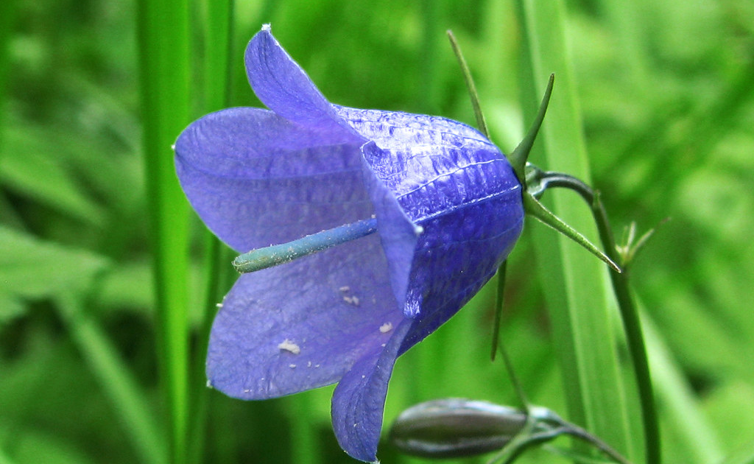
Times Used: Number Used: Level:
Blue Bellflower
This Photo by Unknown Author is licensed under CC BY-NC-ND

Slide 4
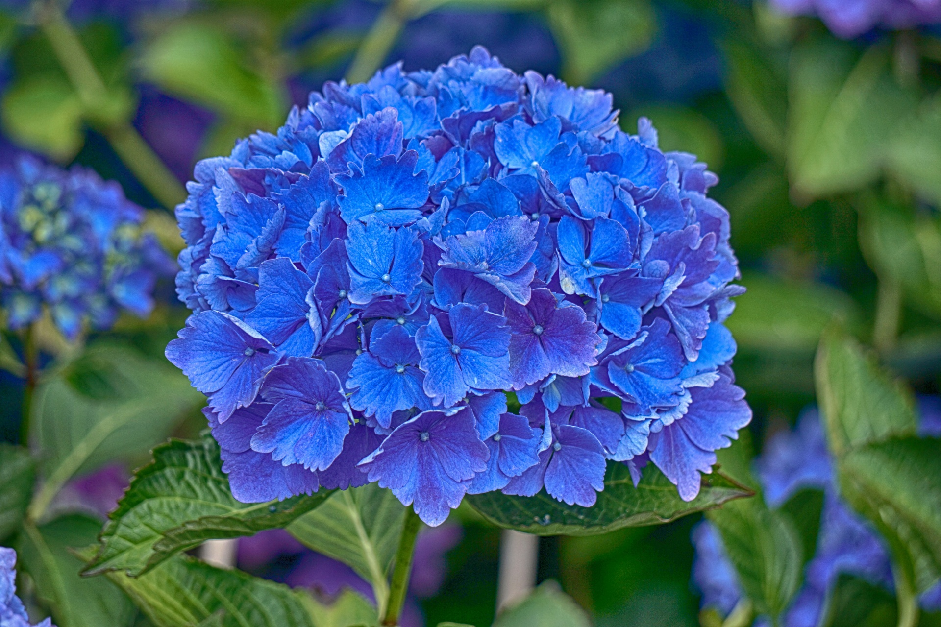
Times Used: Number Used: Level:
Blue Hydrangea

Slide 5
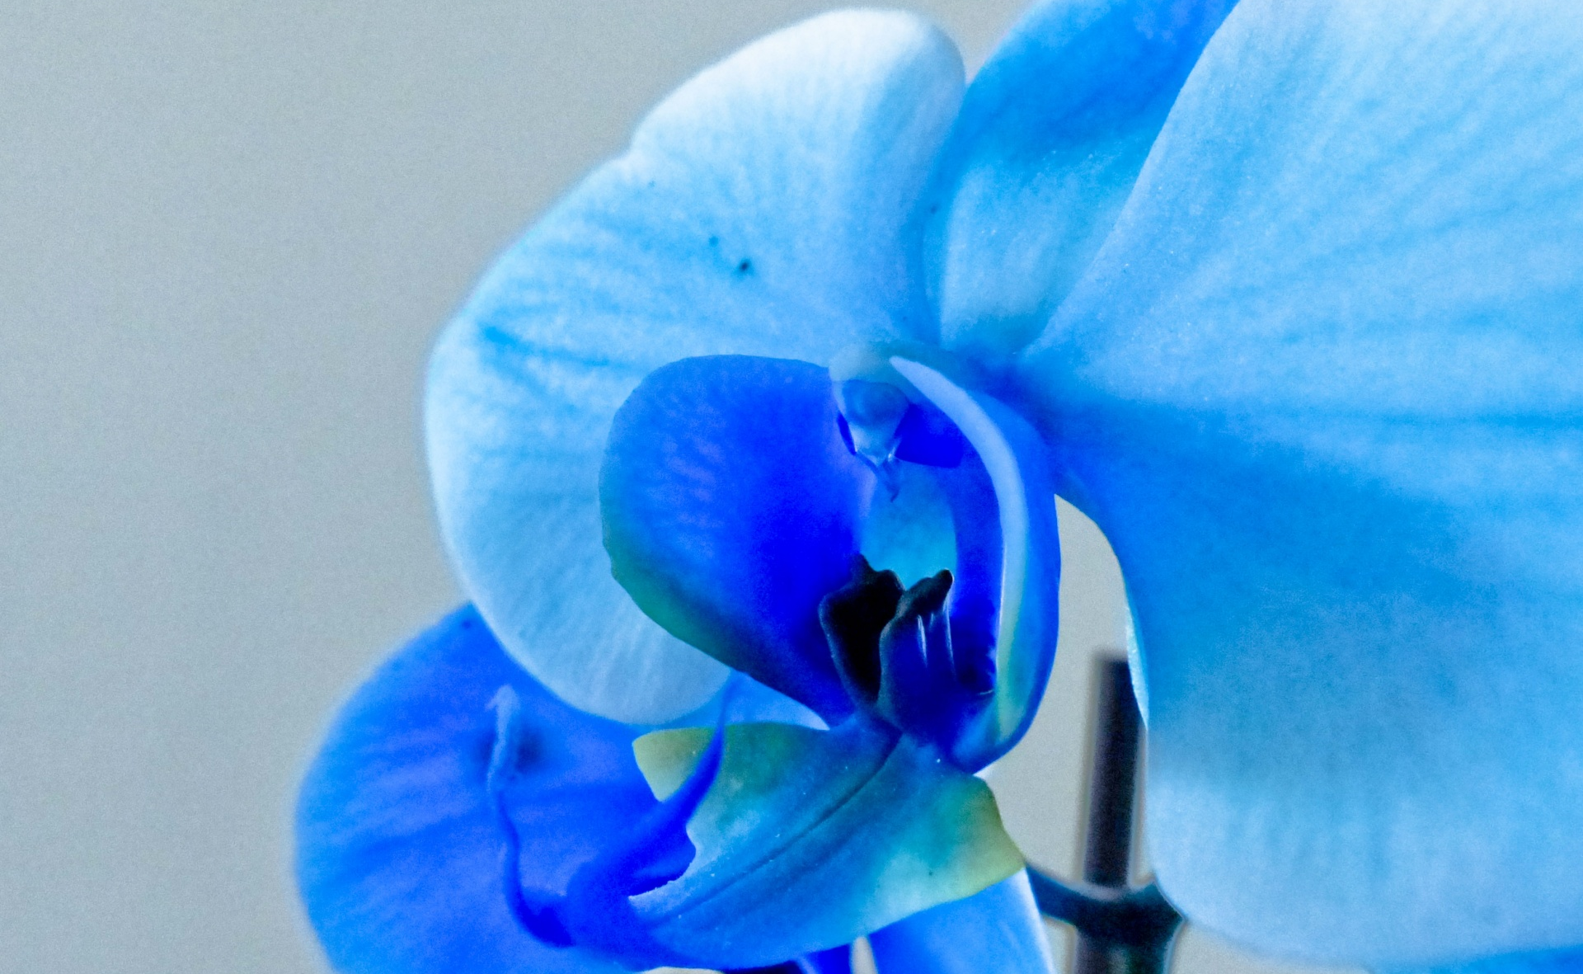
Times Used: Number Used: Level:
Blue Orchid

Slide 6
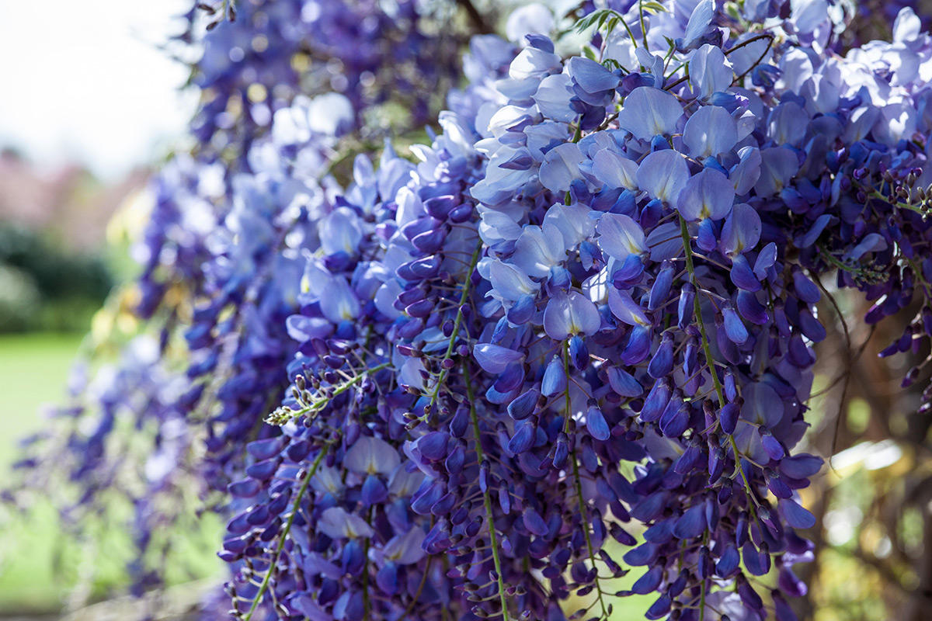
Times Used: Number Used: Level:
Blue Wisteria

Slide 7
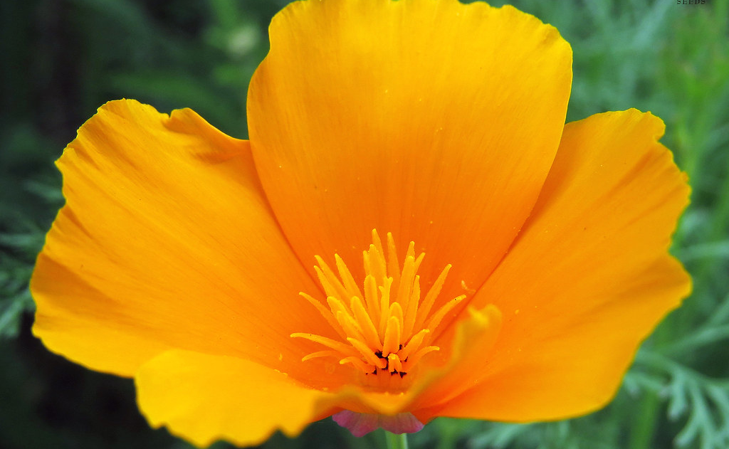
Times Used: Number Used: Level:
California Poppy
This Photo by Unknown Author is licensed under CC BY

Slide 8
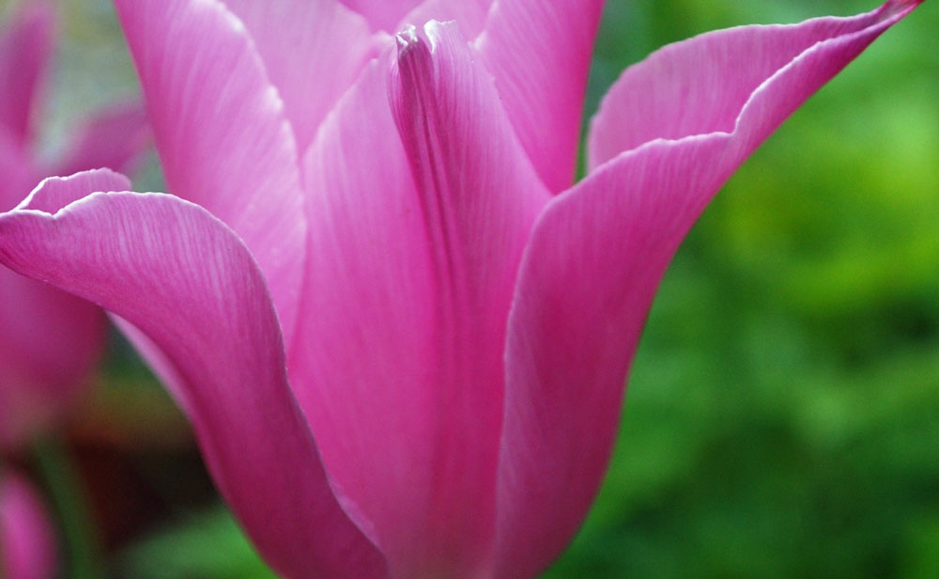
Times Used: Number Used: Level:
China Pink Tulip

Slide 9
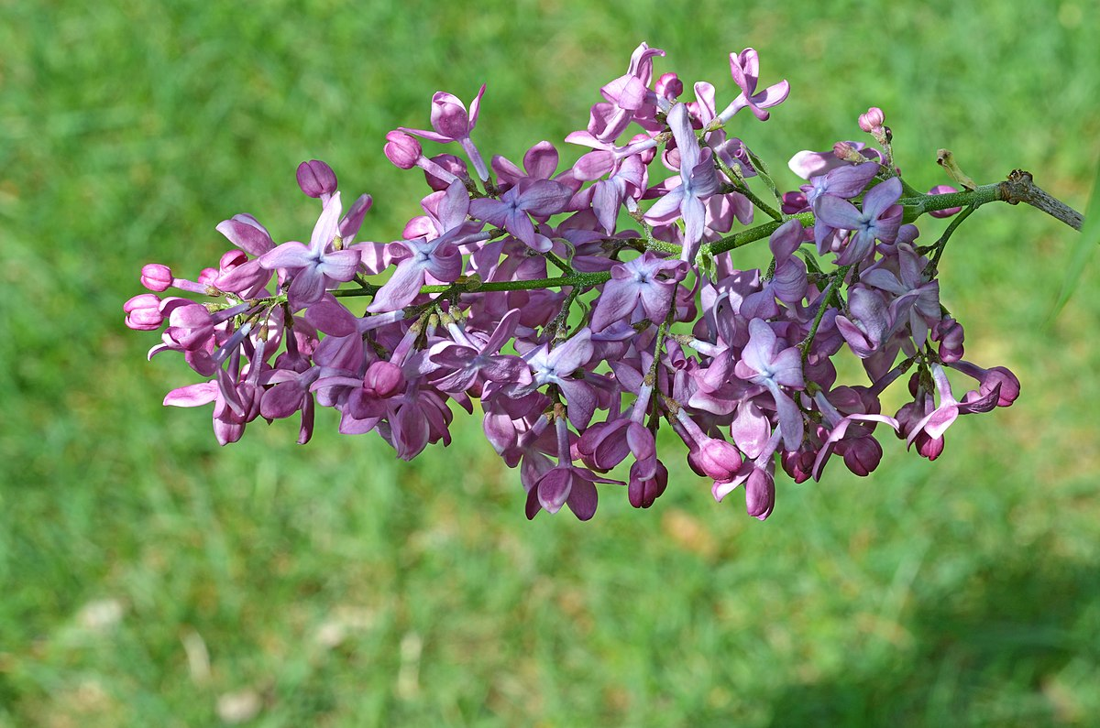
Times Used: Number Used: Level:
Common Lilac
This Photo by Unknown Author is licensed under CC BY-SA

Slide 10
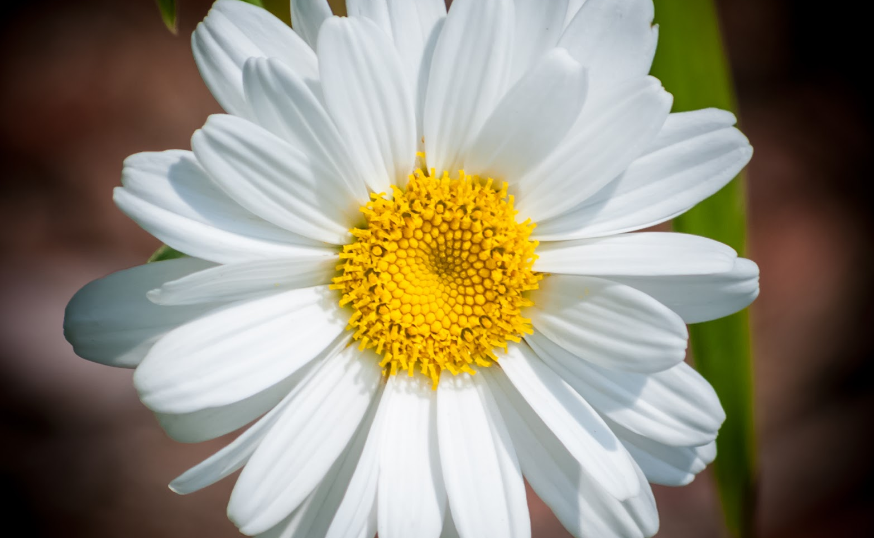
Times Used: Number Used: Level:
Daisy
This Photo by Unknown Author is licensed under CC BY

Slide 11
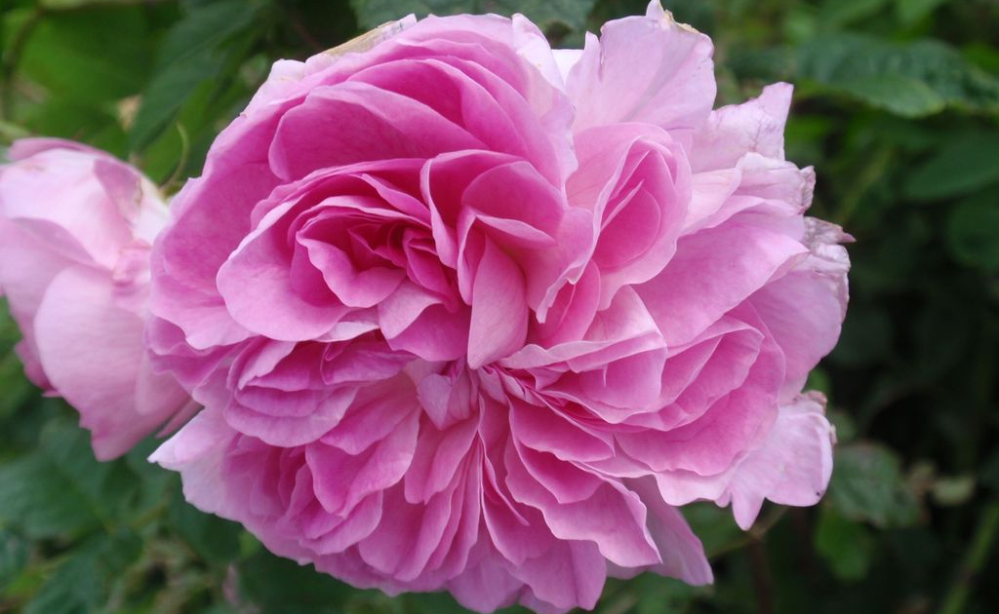
Times Used: Number Used: Level:
Damask Rose
This Photo by Unknown Author is licensed under CC BY-NC

Slide 12
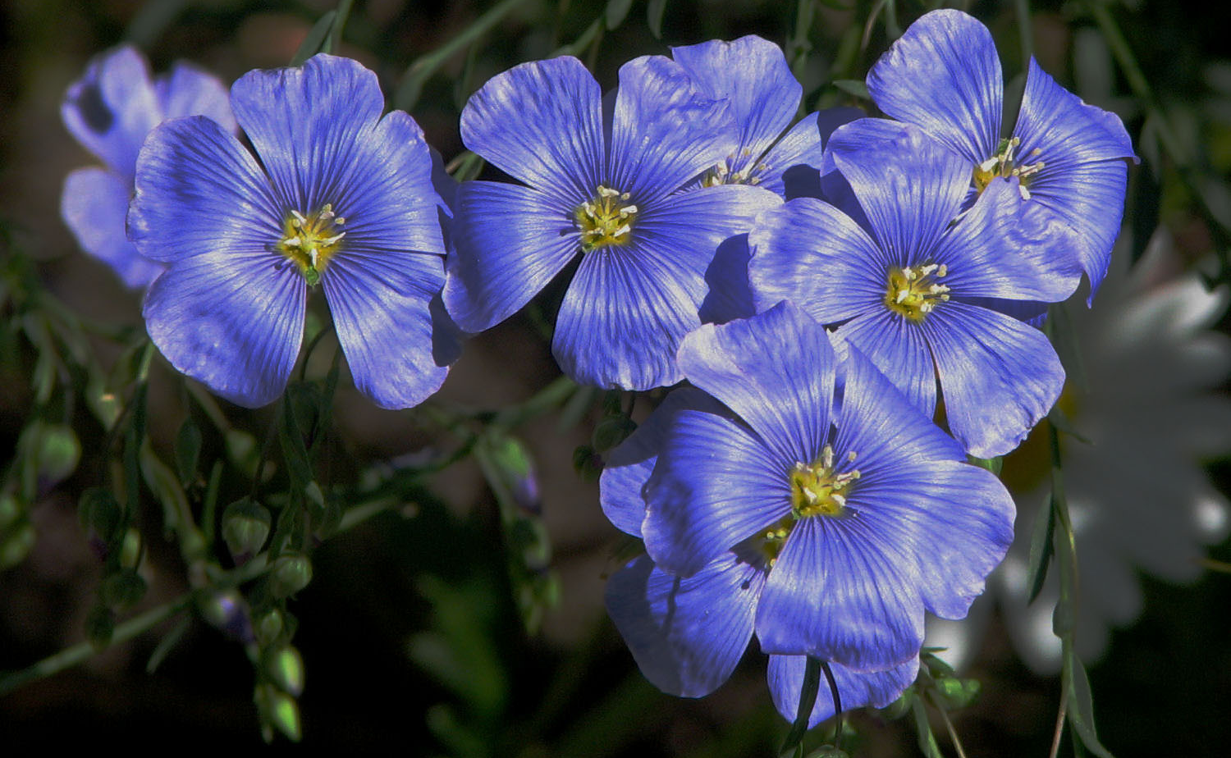
Times Used: Number Used: Level:
Flax
This Photo by Unknown Author is licensed under CC BY-SA

Slide 13
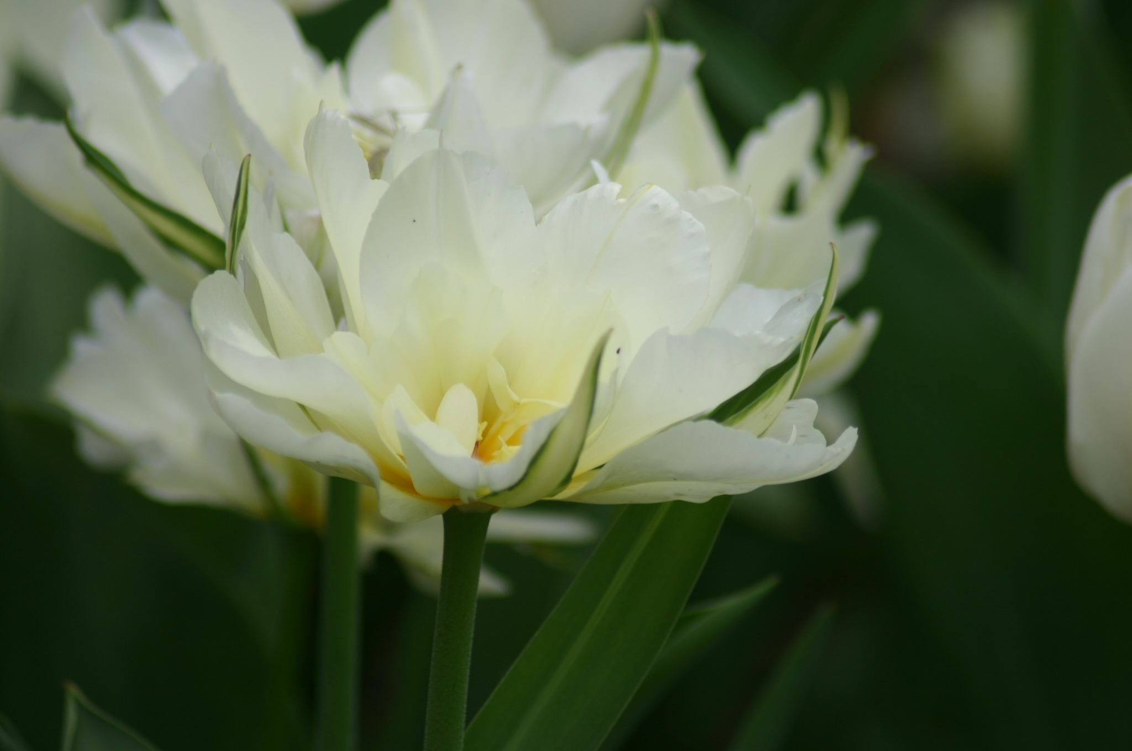
Times Used: Number Used: Level:
Fostriana Tulip
This Photo by Unknown Author is licensed under CC BY-SA

Slide 14
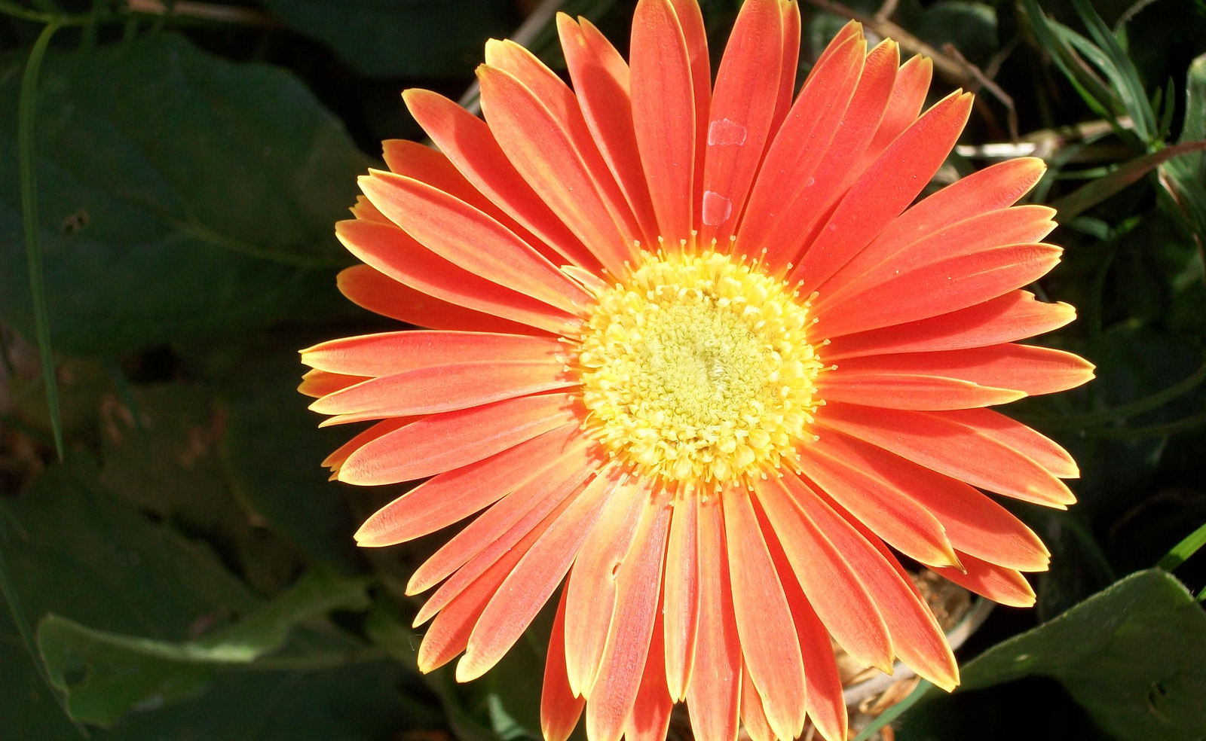
Times Used: Number Used: Level:
Gerbera Daisy
This Photo by Unknown Author is licensed under CC BY-NC-ND

Slide 15
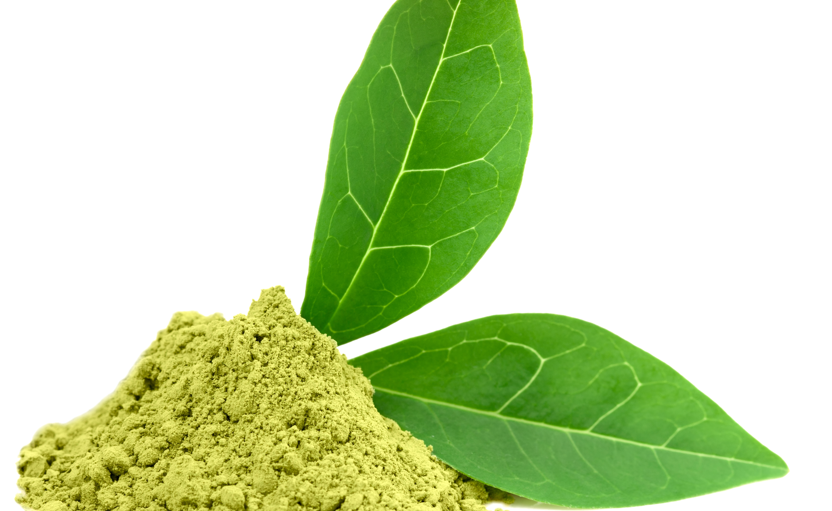
Times Used: Number Used: Level:
Green Tea
This Photo by Unknown Author is licensed under CC BY-NC

Slide 16
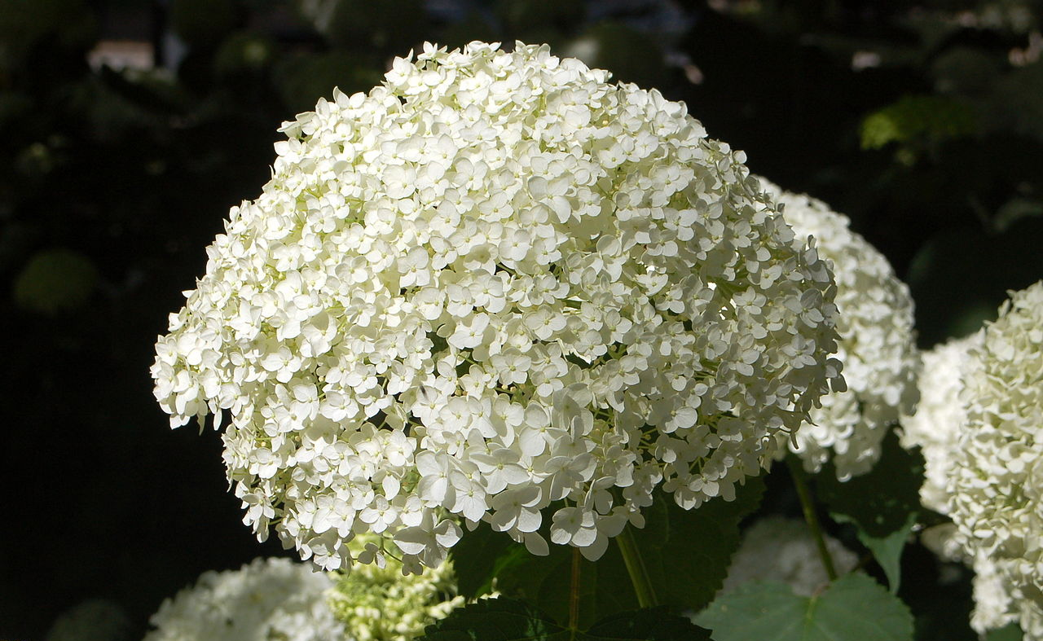
Times Used: Number Used: Level:
Hydrangea
This Photo by Unknown Author is licensed under CC BY-SA

Slide 17
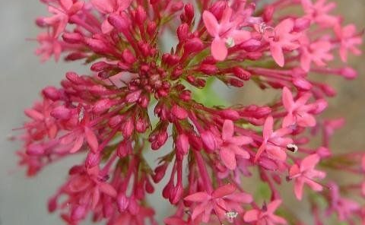
Times Used: Number Used: Level:
Jupiter's Beard

Slide 18
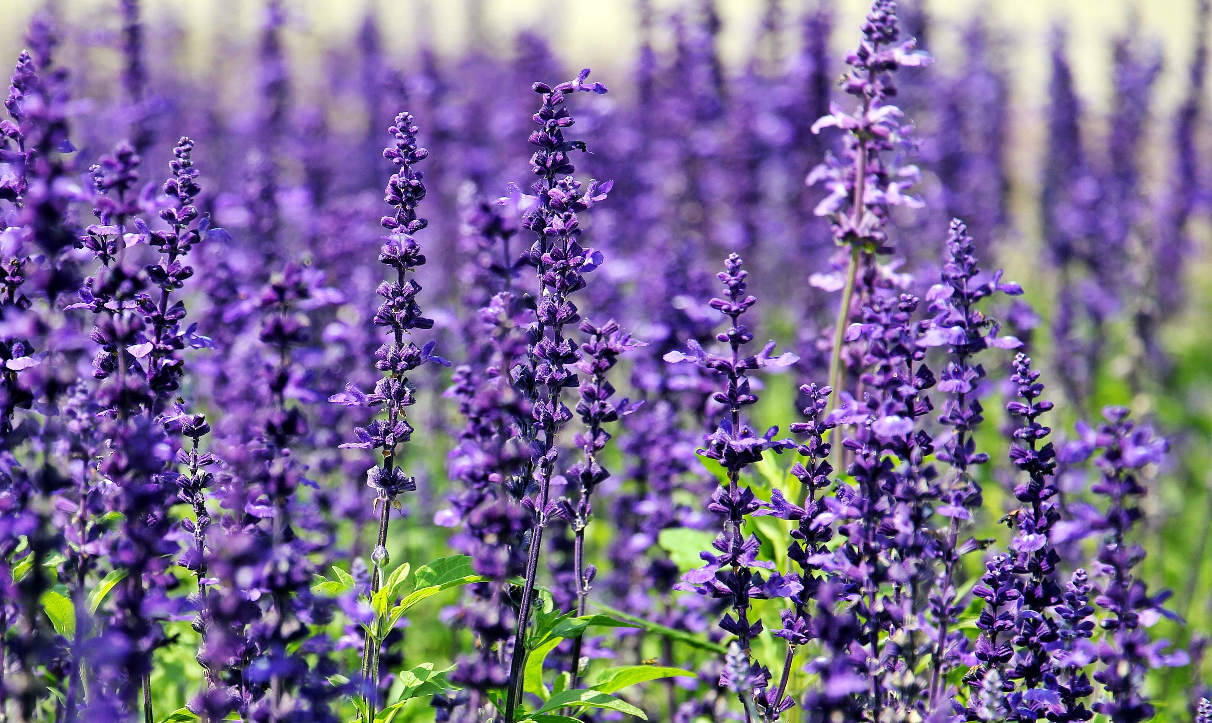
Times Used: Number Used: Level:
Lavender

Slide 19
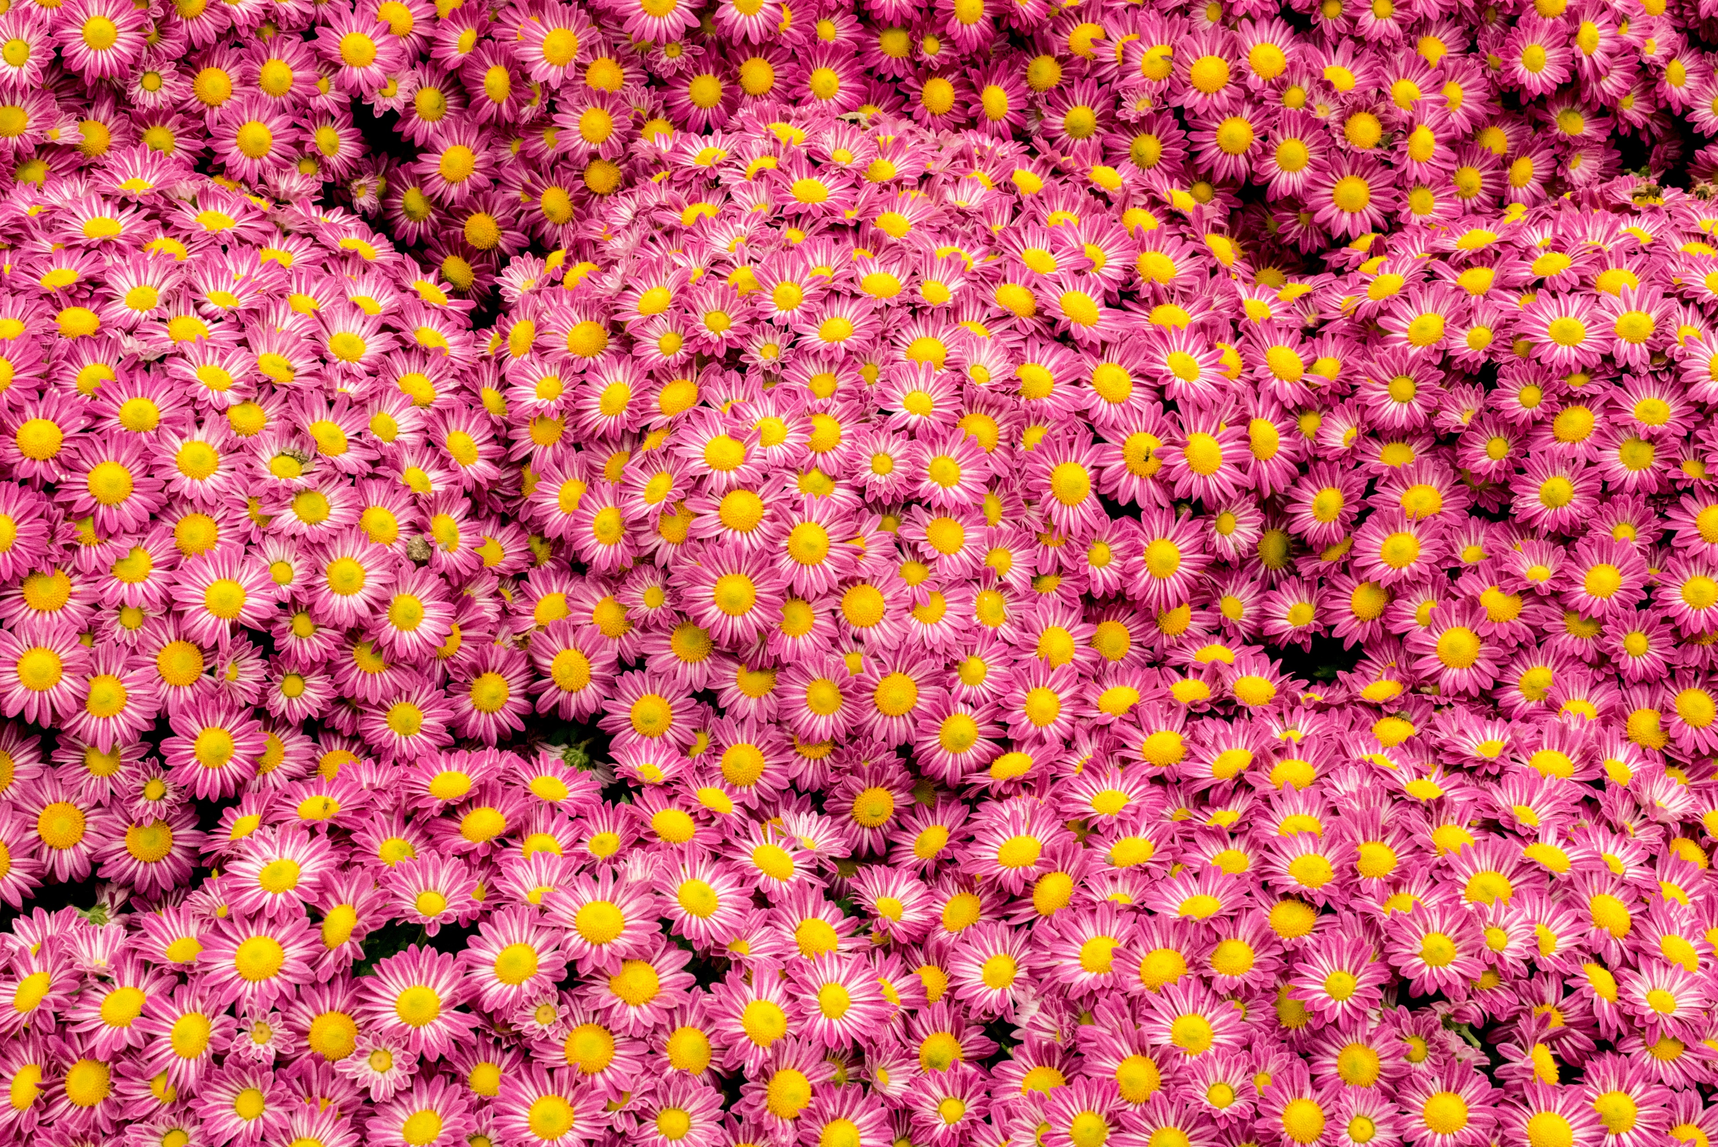
Times Used: Number Used: Level:
Marguerite Daisy

Slide 20
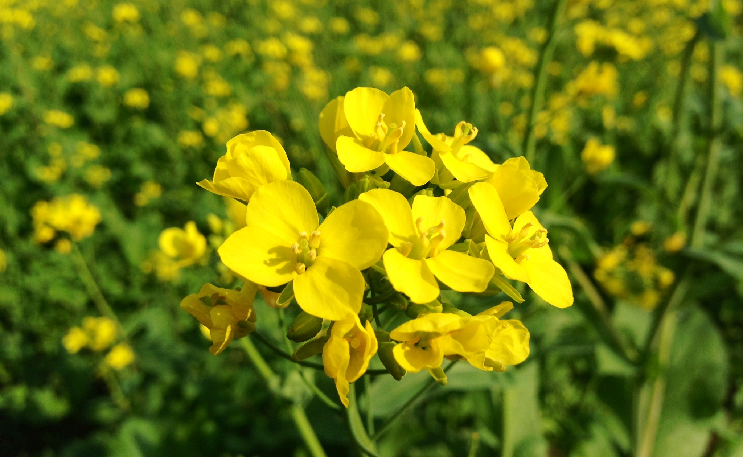
Times Used: Number Used: Level:
Mustard
This Photo by Unknown Author is licensed under CC BY-SA

Slide 21
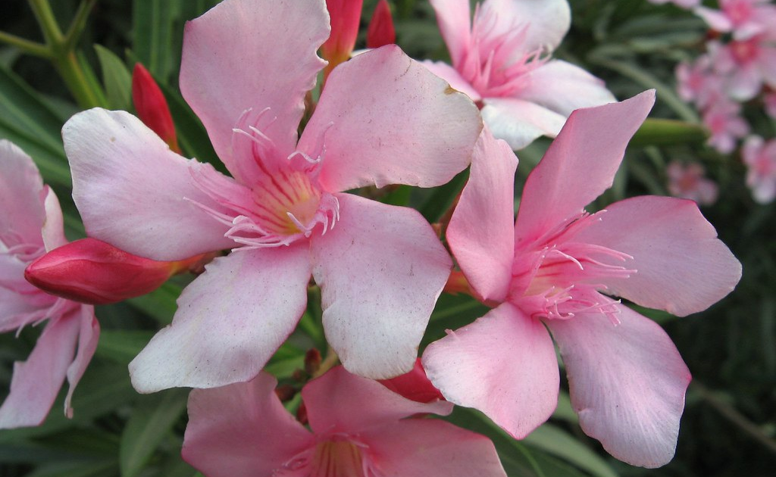
Times Used: Number Used: Level:
Oleander
This Photo by Unknown Author is licensed under CC BY-NC-ND

Slide 22
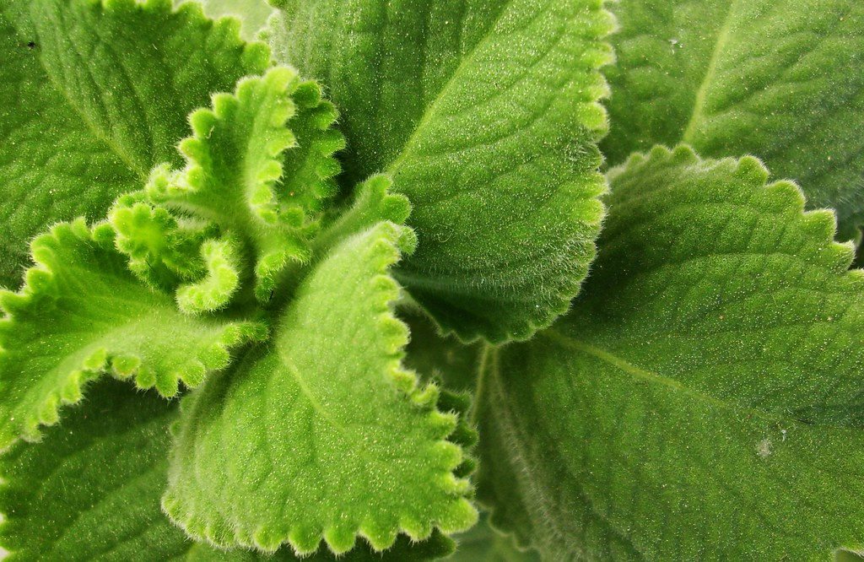
Times Used: Number Used: Level:
Oregano
This Photo by Unknown Author is licensed under CC BY-SA

Slide 23
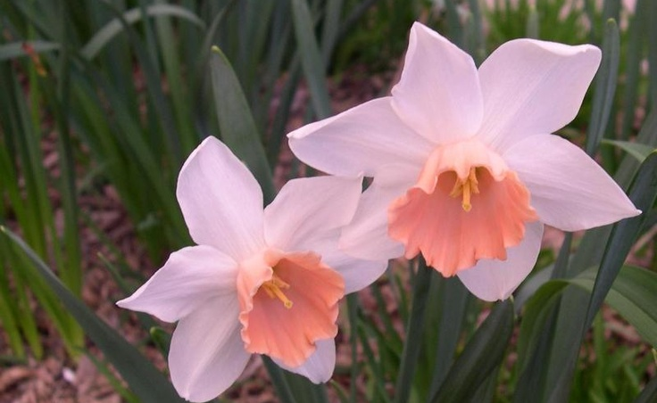
Times Used: Number Used: Level:
Pink Daffodil

Slide 24
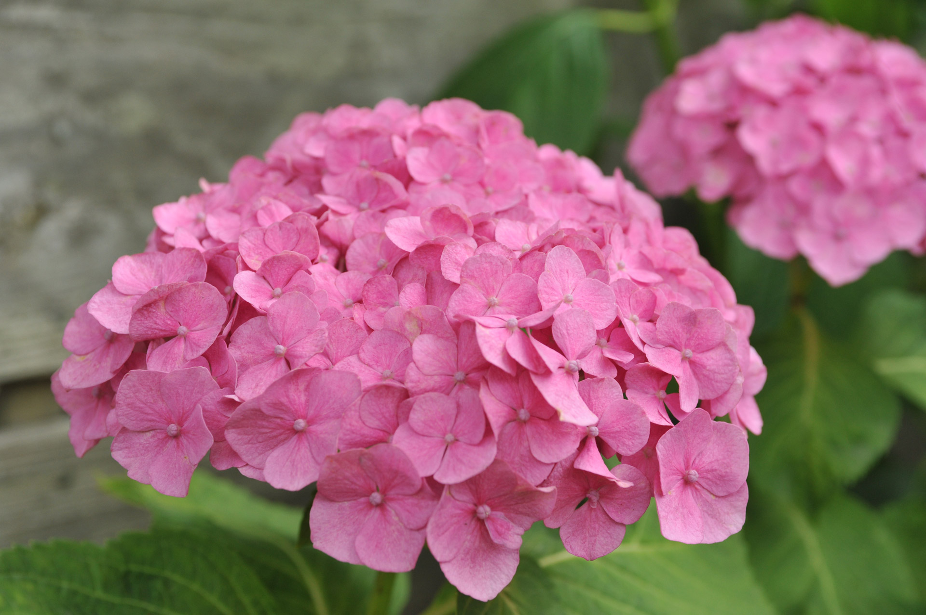
Times Used: Number Used: Level:
Pink Hydrangea

Slide 25
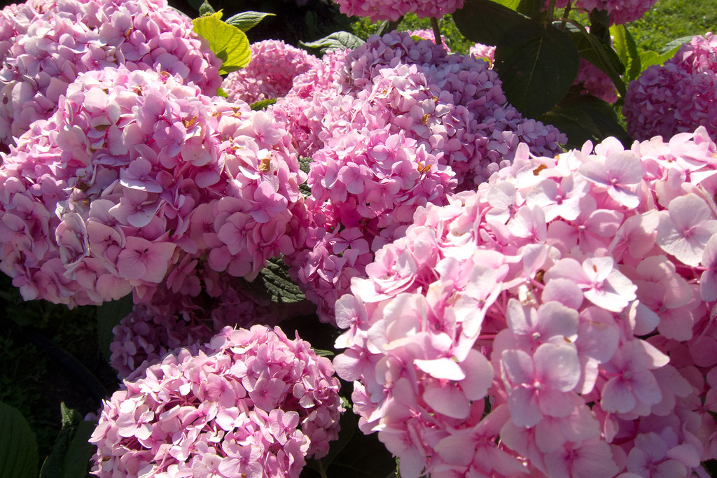
Times Used: Number Used: Level:
Pink Lilac
This Photo by Unknown Author is licensed under CC BY

Slide 26
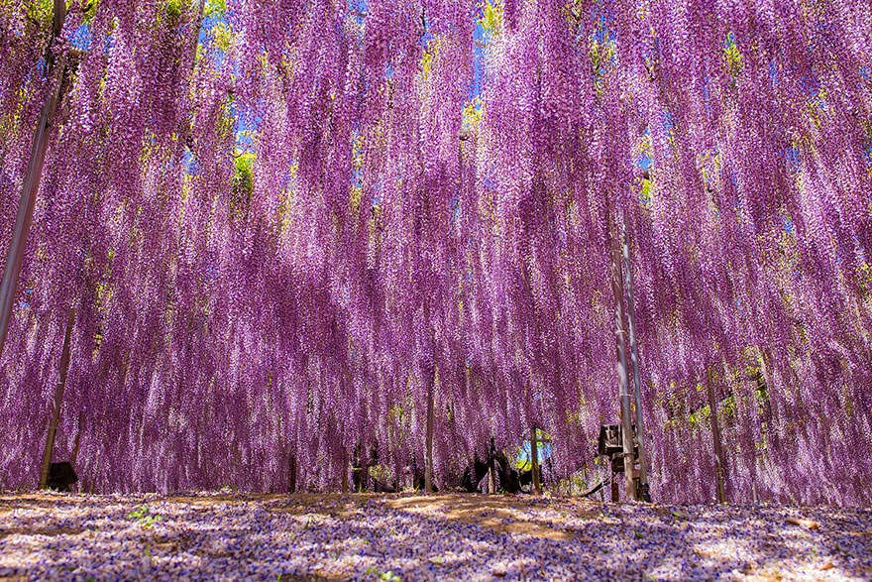
Times Used: Number Used: Level:
Pink Wisteria
This Photo by Unknown Author is licensed under CC BY

Slide 27
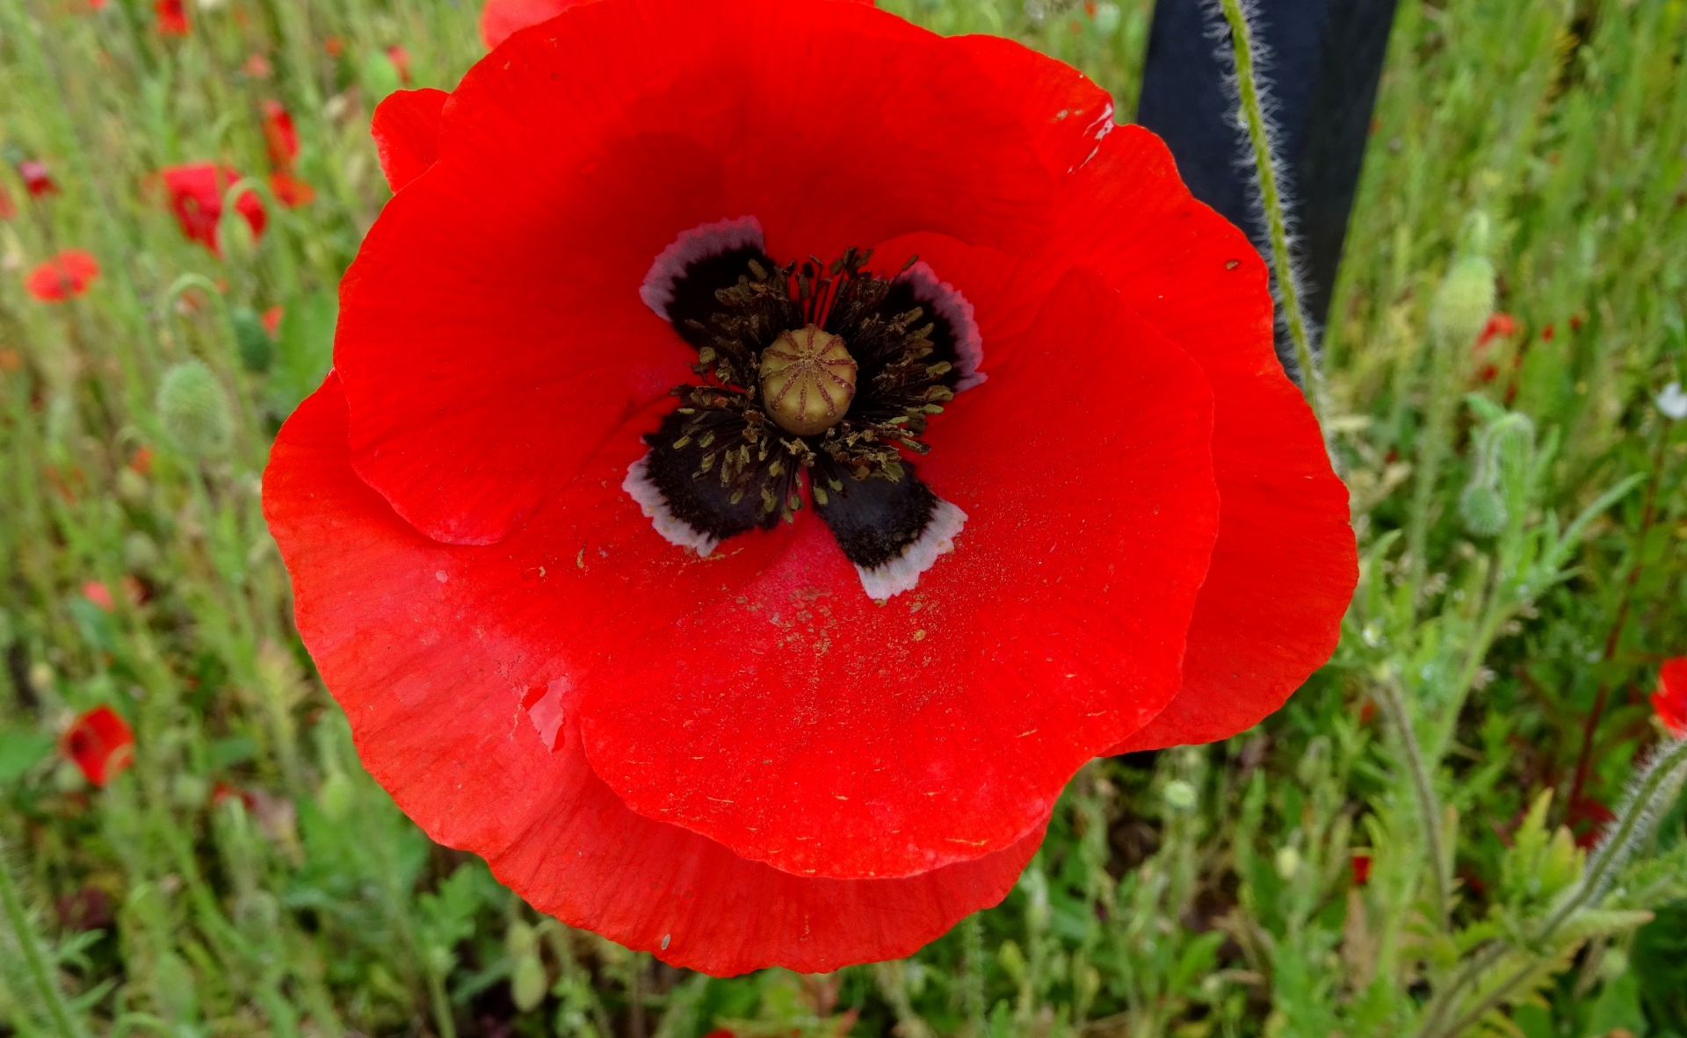
Times Used: Number Used: Level:
Poppy

Slide 28
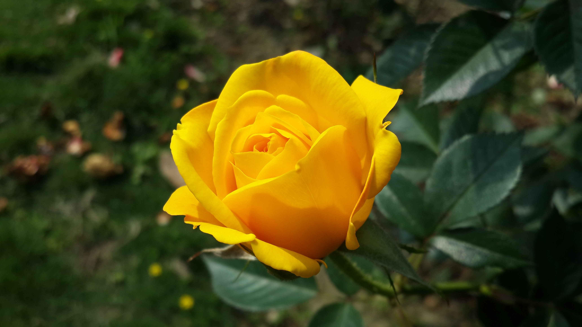
Times Used: Number Used: Level:
Provence Rose

Slide 29
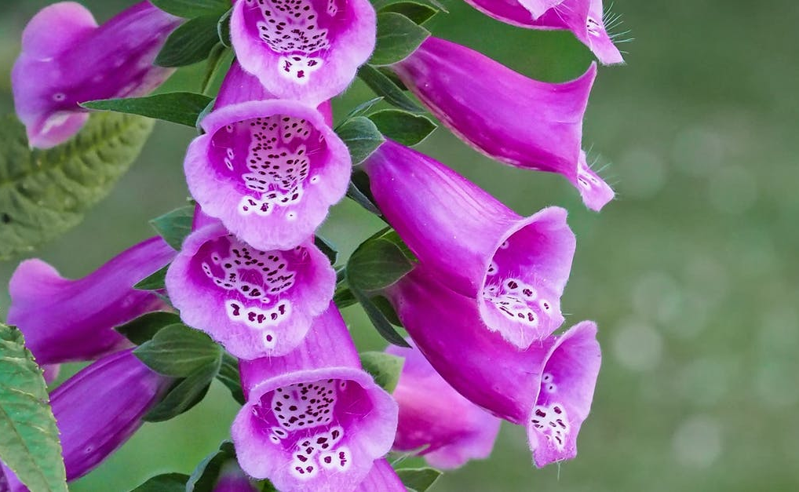
Times Used: Number Used: Level:
Purple Bell Flower

Slide 30
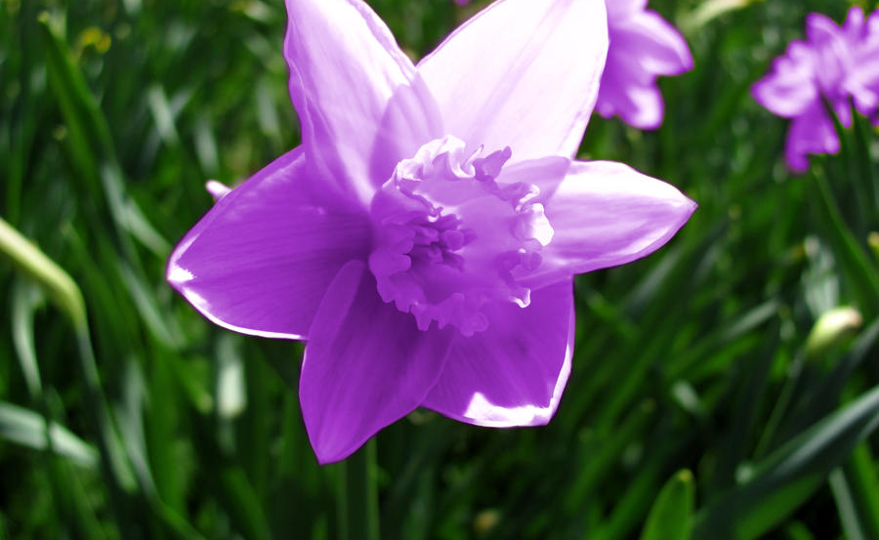
Times Used: Number Used: Level:
Purple Daffodil

Slide 31
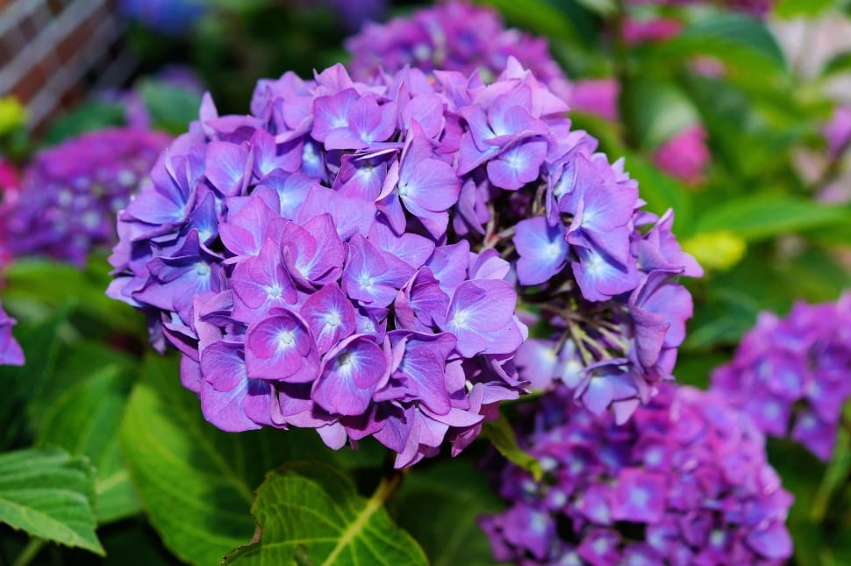
Times Used: Number Used: Level:
Purple Hydrangea

Slide 32
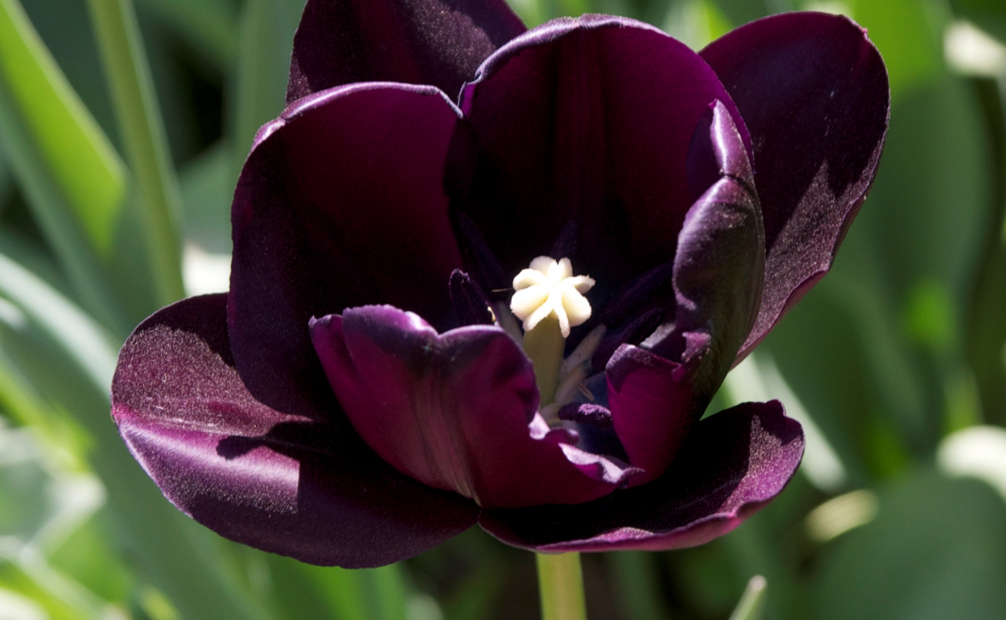
Times Used: Number Used: Level:
Queen of the Night Tulip
This Photo by Unknown Author is licensed under CC BY-SA

Slide 33
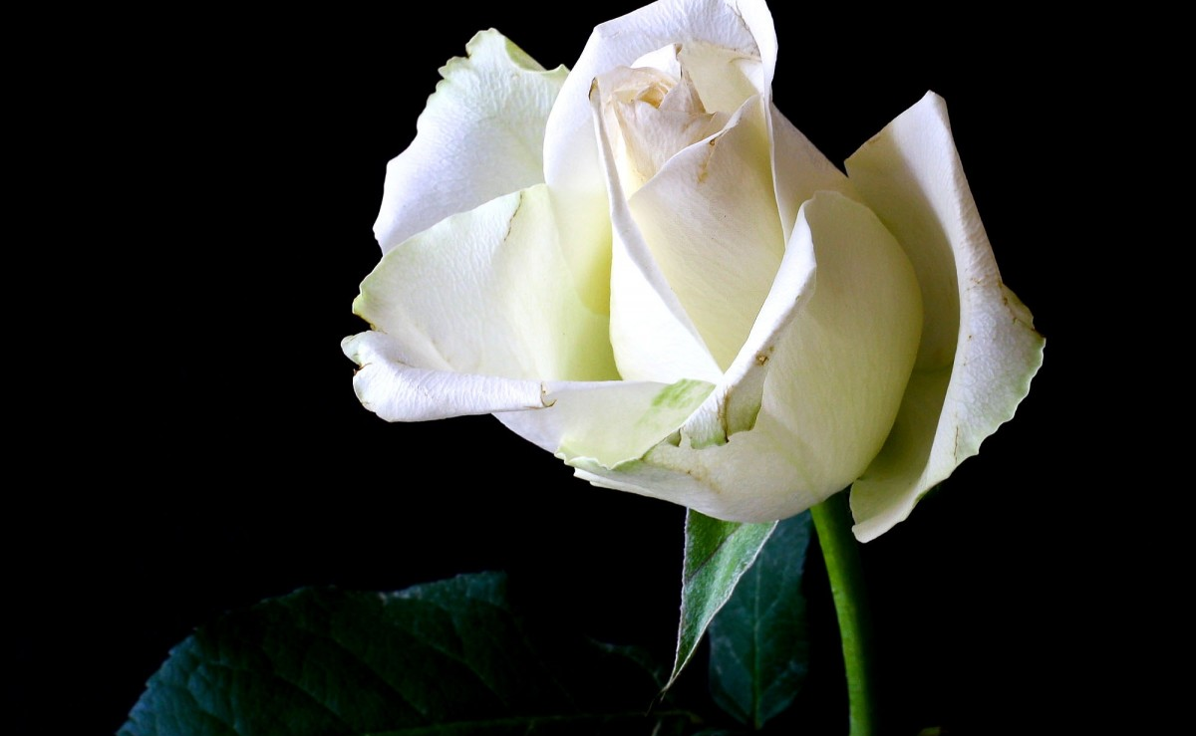
Times Used: Number Used: Level:
Ramana’s Rose

Slide 34
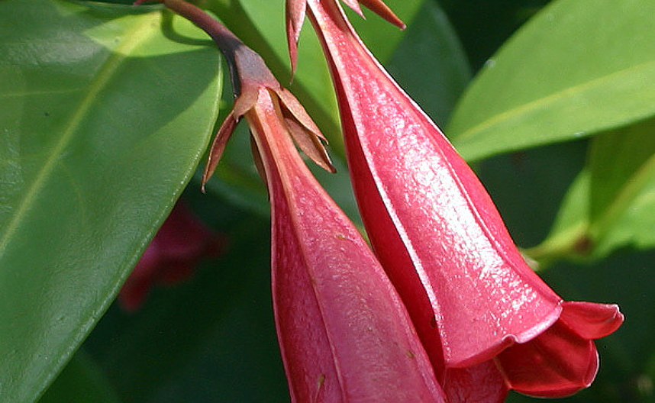
Times Used: Number Used: Level:
Red Bell Flower

Slide 35
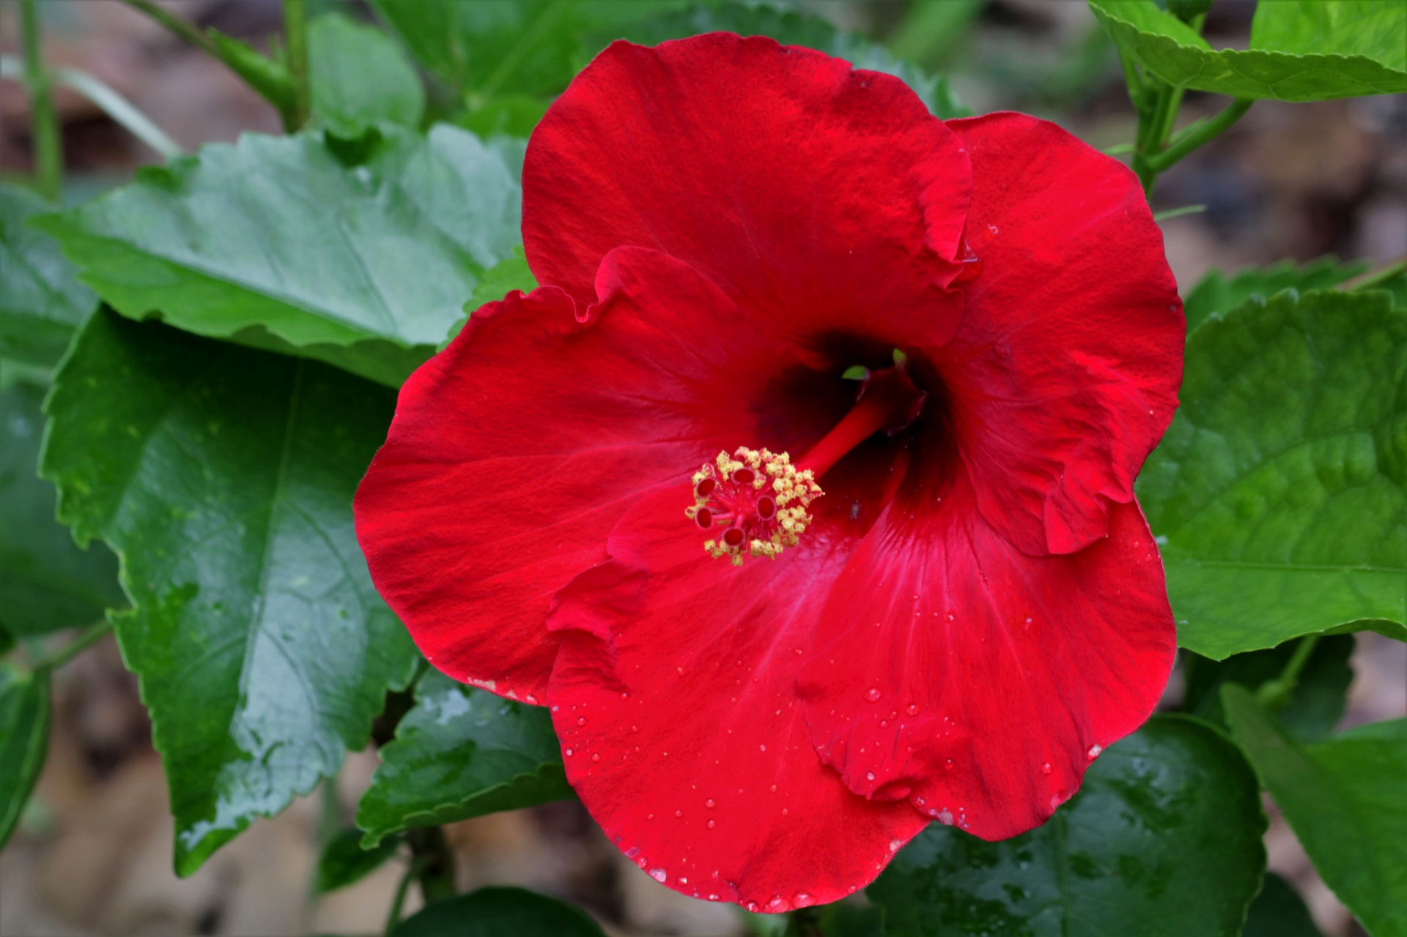
Times Used: Number Used: Level:
Red Hibiscus

Slide 36
Times Used: Number Used: Level:
Red Orchid

Slide 37
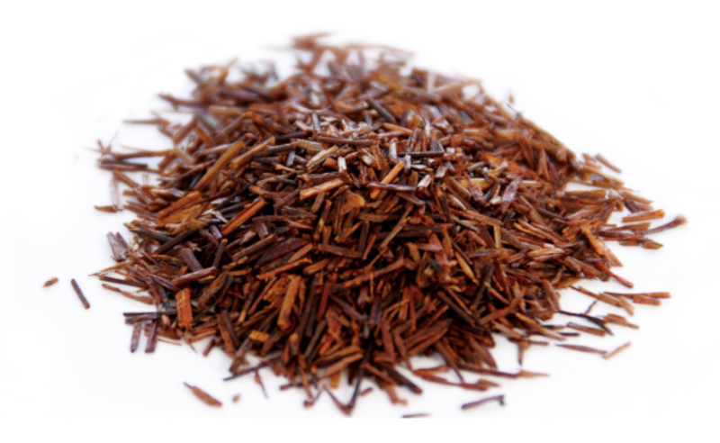
Times Used: Number Used: Level:
Red Tea
This Photo by Unknown Author is licensed under CC BY-NC-ND

Slide 38
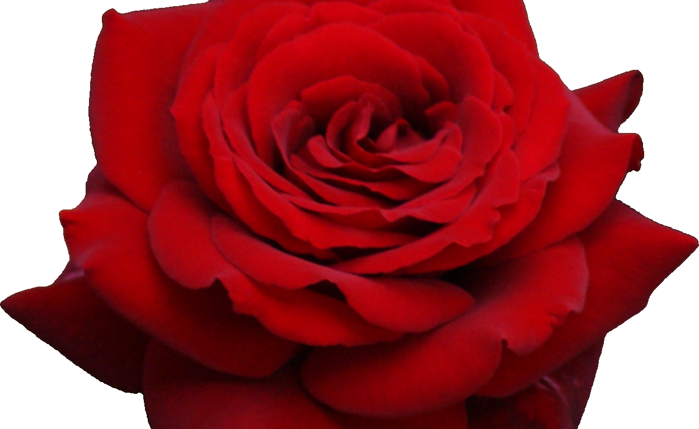
Times Used: Number Used: Level:
Rose
This Photo by Unknown Author is licensed under CC BY-NC

Slide 39
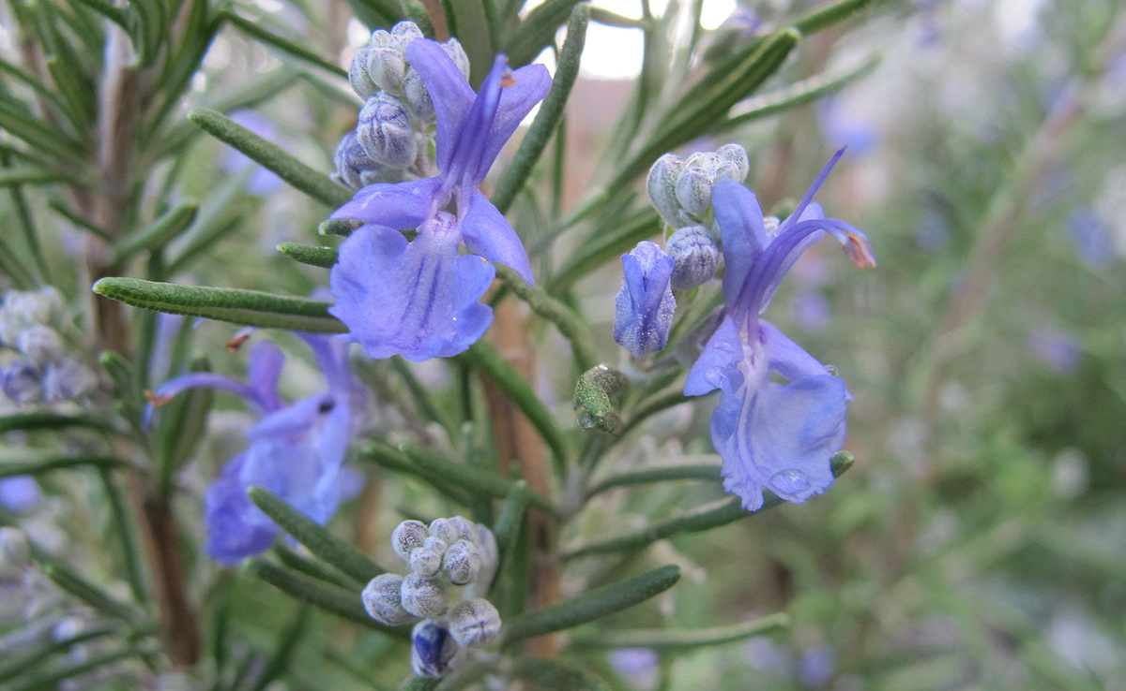
Times Used: Number Used: Level:
Rosemary
This Photo by Unknown Author is licensed under CC BY-SA

Slide 40
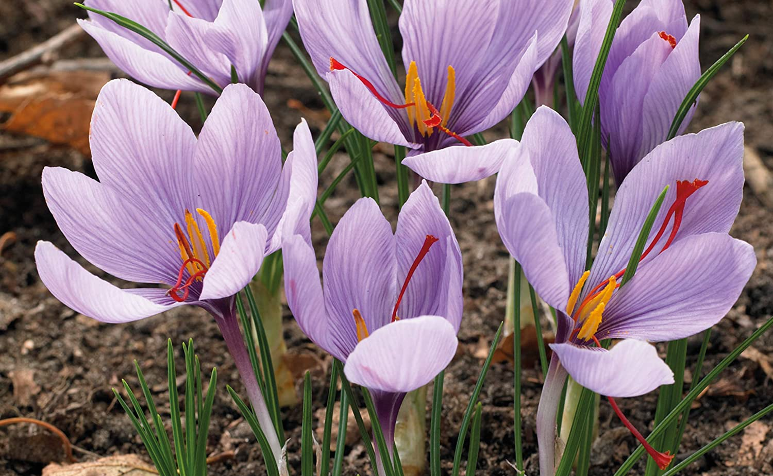
Times Used: Number Used: Level:
Saffron Crocus
This Photo by Unknown Author is licensed under CC BY

Slide 41
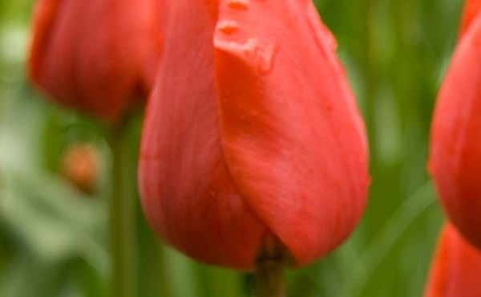
Times Used: Number Used: Level:
Sevilla Tulip

Slide 42
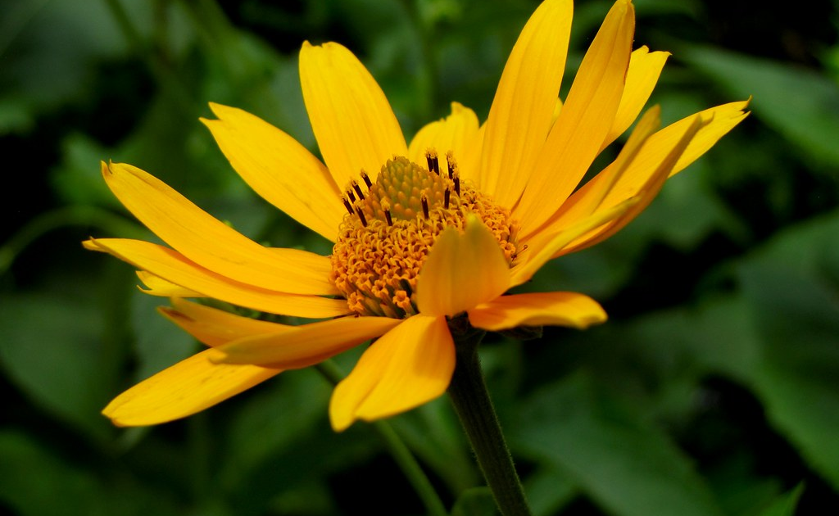
Times Used: Number Used: Level:
Shasta Daisy
This Photo by Unknown Author is licensed under CC BY-SA

Slide 43
Times Used: Number Used: Level:
Strong Gold Tulip

Slide 44
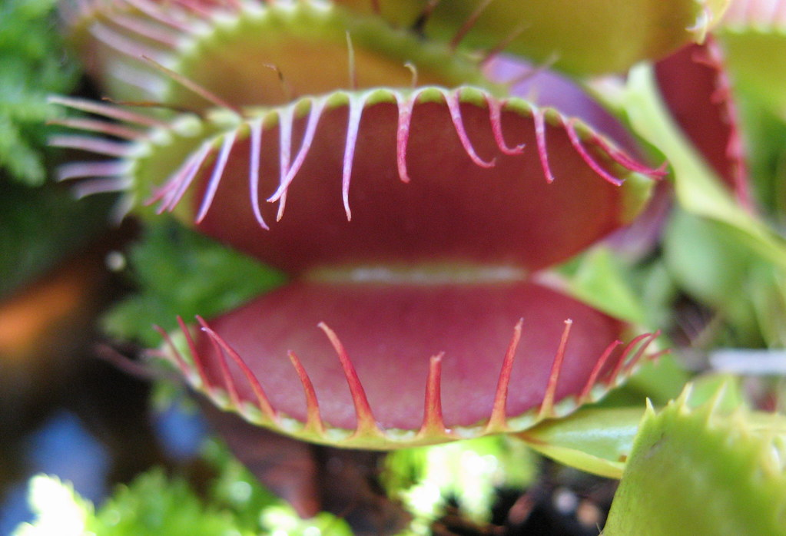
Times Used: Number Used: Level:
Venus Flytrap
This Photo by Unknown Author is licensed under CC BY-NC-ND

Slide 45
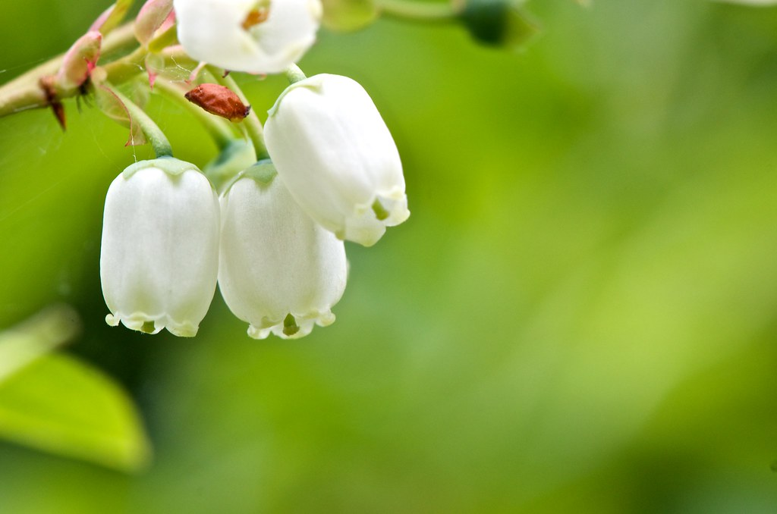
Times Used: Number Used: Level:
White Bell Flower
This Photo by Unknown Author is licensed under CC BY-NC-ND

Slide 46
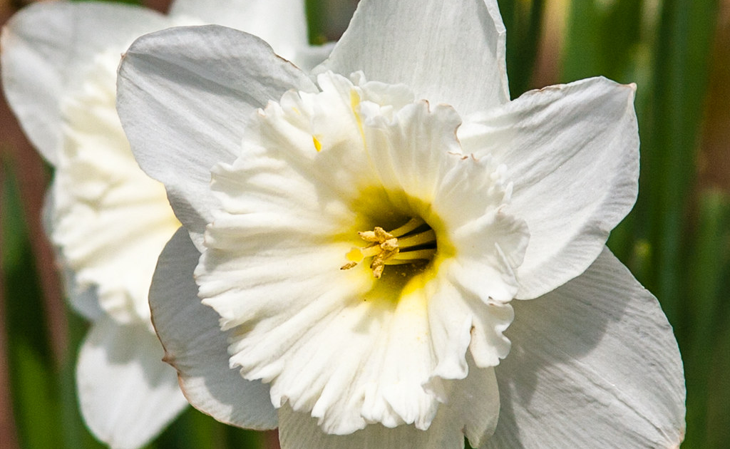
Times Used: Number Used: Level:
White Daffodil
This Photo by Unknown Author is licensed under CC BY

Slide 47
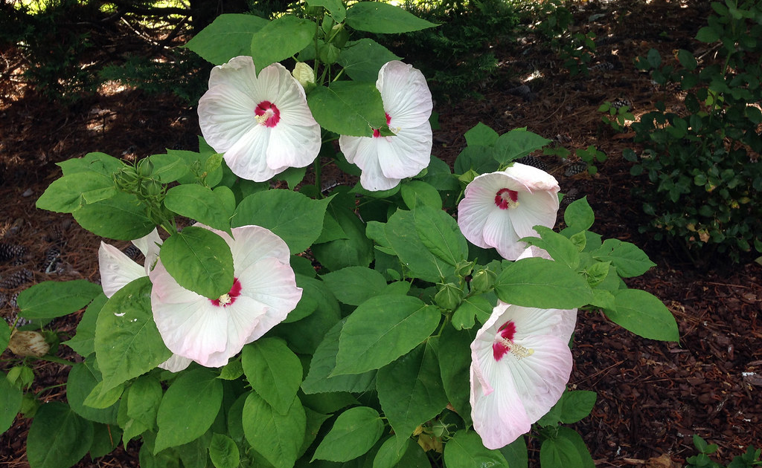
Times Used: Number Used: Level:
White Hibiscus
This Photo by Unknown Author is licensed under CC BY-SA-NC

Slide 48
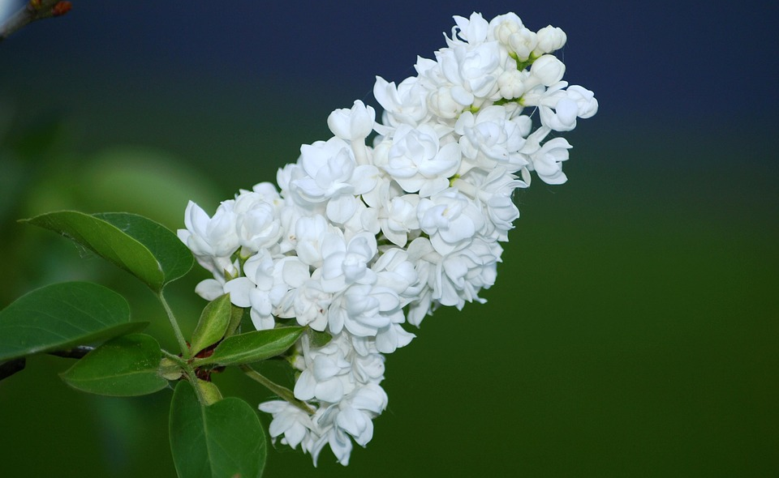
Times Used: Number Used: Level:
White Lilac

Slide 49
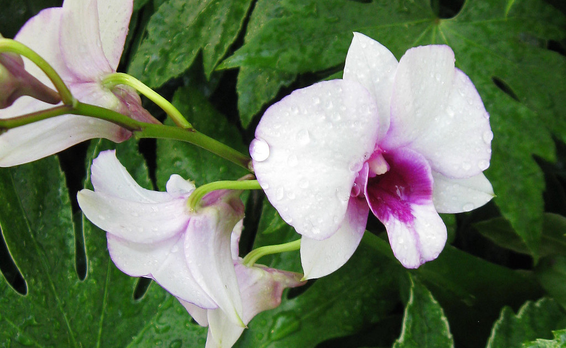
Times Used: Number Used: Level:
White Orchid
This Photo by Unknown Author is licensed under CC BY-NC

Slide 50
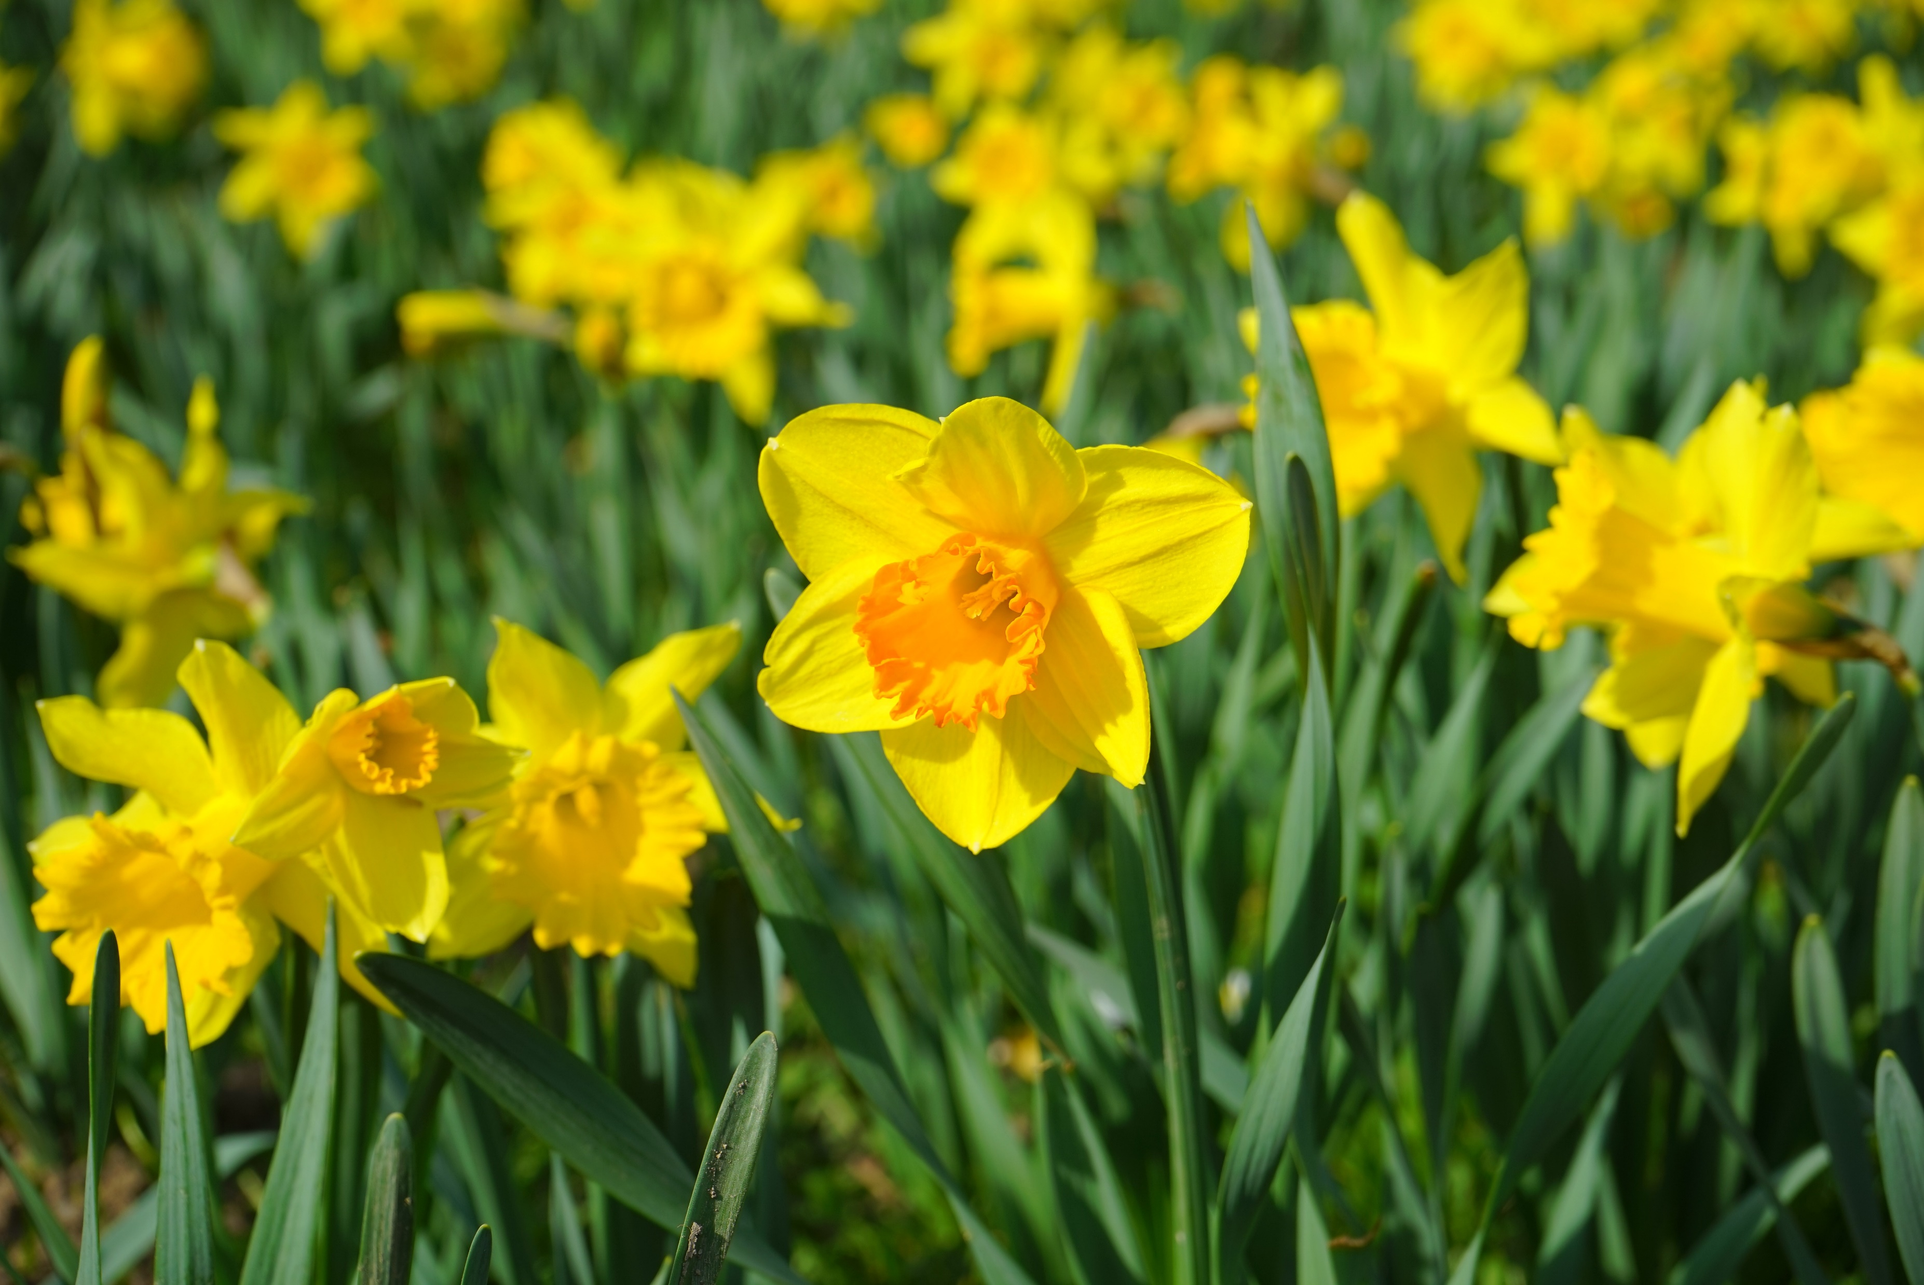
Times Used: Number Used: Level:
Yellow Daffodil

Slide 51
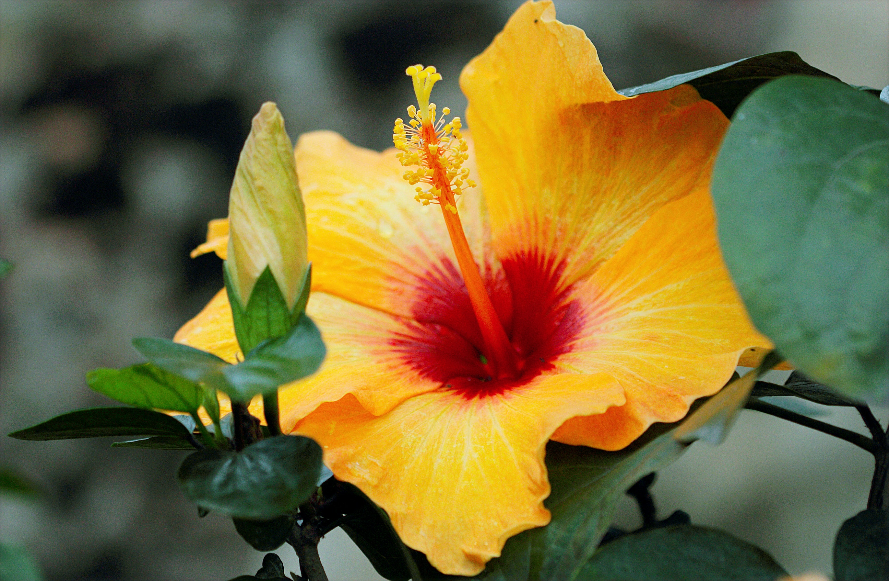
Times Used: Number Used: Level:
Yellow Hibiscus

Slide 52
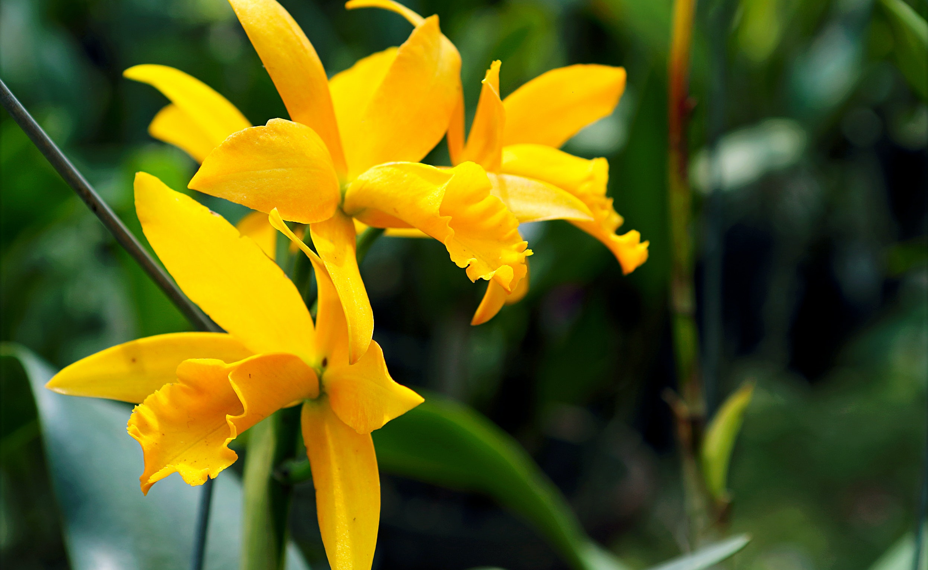
Times Used: Number Used: Level:
Yellow Orchid

Slide 53
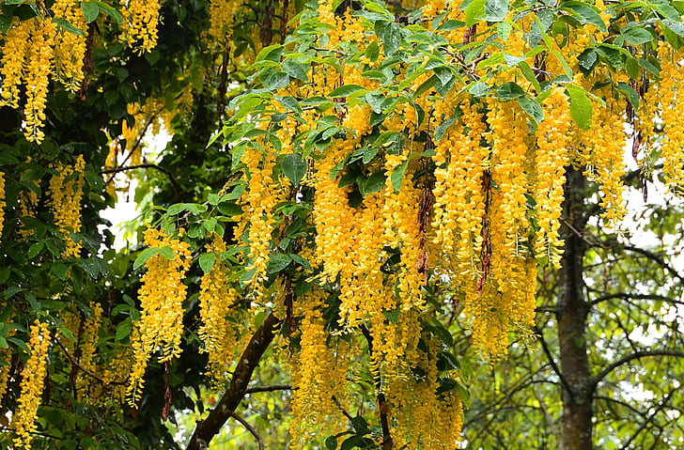
Times Used: Number Used: Level:
Yellow Wisteria

